Slide 1

Movie Ticket Booking System
Team 4
Bhuvaneshkumar Jotheeswaran - 002136250 Mrudul Hemant Ladhwe - 001000309 Priyanka Neethipudi - 002199041 Kunal Desai - 002193570

Slide 2

BACKGROUND:
In the past, booking movie tickets has always been a task where people would have to wait in long queues. To overcome this issue, a ticket booking system was introduced.
A ticket booking system is a Database Management System (DBMS) that stores customer and movie booking data.
This system allows customers to book their ticket at their convenient theater, choose their seats, and on their preferred date to watch the movie.
This project emphasizes a better customer experience by facilitating cost- efficient solutions, user-friendly options, easy and quick booking, and faster payout options, providing an overall hustle-free experience.

Slide 3


COntents
Objectives
Design Approach
Entity Relation Diagram
Database Objects
Tableau Dashboard
Insert Scripts

Slide 4
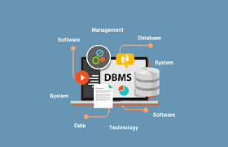
OBJECTIVES:
Creating and storing account details of all users.
Centralized system that consists of all the movie theater screenings from which customers can book tickets in a theater from list of many theaters in one place.
Providing data to determine the frequency to air shows depending upon how fast the past tickets get booked.
Providing discounts to student accounts and to premium customers to use the platform more frequently.
Displaying seating (lower seats, middle seats, balcony, etc.) and pricing information of a particular theatre.
Handling customer complaints.
Rating and review for the movie by each customer.

Slide 5
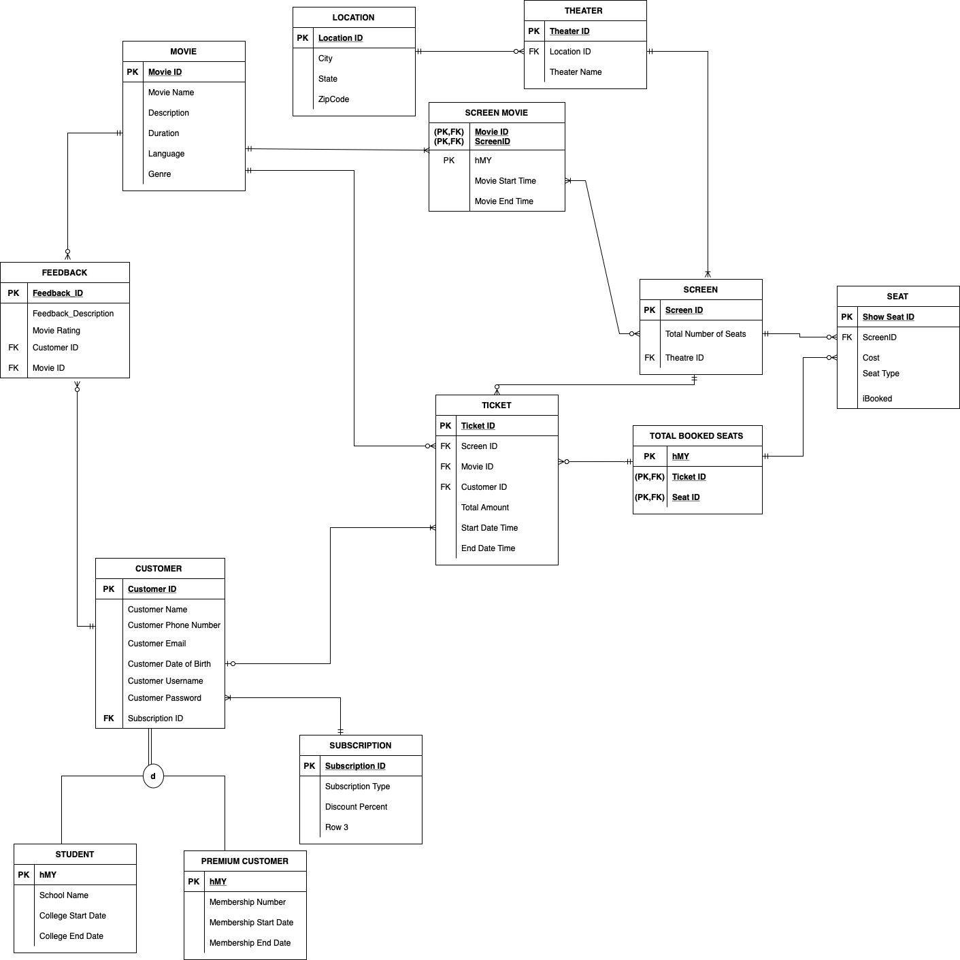
Entity Relationship Diagram

Slide 6
Database Object - Tables
Customer
Subscription
Student
Premium Customer
Location
Movie
Theatre
Screen
Screen Movie
Seat
Ticket
Total Booked Seats
Feedback

Slide 7



Database Objects – Stored Procedures
Stored Procedures:
Procedure to Find all Theatres of a City
Procedure to Add a New Customer
Procedure to Book Ticket

Slide 8
Stored Procedure 1
Procedure to add a new customer to the database
IF EXISTS(Select 1 from sys.objects where name ='AddCustomer')
DROP PROCEDURE AddCustomer
GO
CREATE PROCEDURE AddCustomer (
@Username varchar(50),
@Password varchar(50),
@Name varchar(50),
@Phone BIGINT,
@Email varchar(50),
@DOB date,
@SubscriptionType varchar(20),
@ColgName varchar(100),
@MembershipNum BIGINT,
@StartDate date,
@EndDate date
)
AS
DECLARE @Subscription int
DECLARE @ScopeIdentity int
Select @Subscription= case
when @SubscriptionType='Student' then 1
when @SubscriptionType='Premium' then 2
end
Insert into Customer
values
(@Username,@Password,@Name,@Phone,@Email,@DOB,@Subscription)
set @ScopeIdentity=SCOPE_IDENTITY()
If (@SubscriptionType='Student')
BEGIN
Insert into Student
values
(@ScopeIdentity,@ColgName,@StartDate,@EndDate)
END
If (@SubscriptionType='Premium')
BEGIN
Insert into Premium
values
(@ScopeIdentity,@MembershipNum,@StartDate,@EndDate)
END
GO

Slide 9
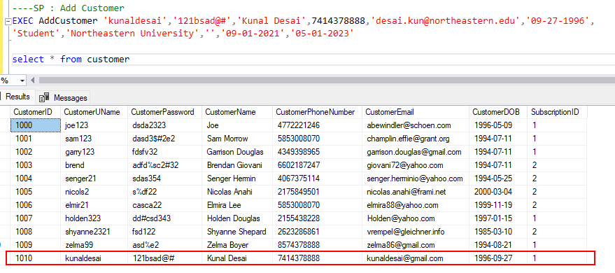
Stored procedure 1
OUTPUT

Slide 10
Stored procedure 2
Procedure to Find all Theatres of a City
IF EXISTS(Select 1 from sys.objects where name ='TheatreByCity')
DROP PROCEDURE TheatreByCity
GO
CREATE PROCEDURE TheatreByCity(
@City varchar(50),
@State varchar(50)
)
AS
Select
l.City,
l.[State],
t.TheatreName
from Theatre t
inner join [Location] l on t.LocationID=l.LocationID
where l.LocationID= (select LocationID from [location] where
City=@City and [state]=@State)
GO

Slide 11
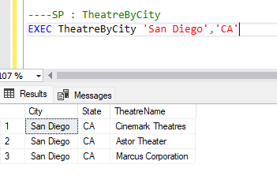
STORED PROCEDURE 2
OUTPUT:

Slide 12
Stored procedure 3
Procedure to Book Ticket
IF EXISTS(Select 1 from sys.objects where name ='TicketBooking')
DROP PROCEDURE TicketBooking
GO
CREATE PROCEDURE TicketBooking(
@CustomerID int,
@Movie_ID int,
@TheatreID int,
@ScreenID int,
@SeatID varchar(20),
@ScreenMovie int
)
AS
DECLARE @ActualAmt numeric(10,2)
DECLARE @Discount numeric(10,2)
SET @Discount=0
DECLARE @DiscountedAmt numeric(10,2)
DECLARE @StartDateTime datetime
DECLARE @EndDateTime datetime Select * into #Temp from dbo.fn_split(@SeatID,',') /*Start - IF NO Seats are available*/
IF (
(select count(seatID) from seat where seatid in (Select [value] from #Temp))=
(select count(seatID) from seat where seatid in (Select [value] from #Temp) and ibooked=1))
BEGIN
select 'The selected Seats are not available'
END
/*End - IF NO Seats are available*/
/*Start - IF Partial Seats are available*/
IF (
(select count(seatID) from seat where seatid in (Select [value] from #Temp))>
(select count(seatID) from seat where seatid in (Select [value] from #Temp) and ibooked=1)
AND
(select count(seatID) from seat where seatid in (Select [value] from #Temp) and ibooked=1)<>0
)
BEGIN
/* Return the partial seats*/
select 'Only SeatID(s): ' + xyz.abc + ' are available.' from
(
SELECT distinct 1 as [ID],
abc = STUFF(
(SELECT ',' +
convert(varchar,seatID) from seat where seatid in (Select [value] from #Temp) and isnull(ibooked,0)=0
FOR XML PATH ('')), 1, 1, ''
)
FROM seat GROUP BY ScreenID
) xyz
END

Slide 13
Stored procedure 3 - Continued
*Start - IF ALL Seats are available*/
IF ((select count(seatID) from seat where seatid in (Select [value] from #Temp) and ibooked=1)=0)
BEGIN
--Book the seats and return the amount or put in Payment table
/*Calculate Actual Amount*/
select @ActualAmt=sum(cost)
from seat
where seatid in ((Select [value] from #Temp))
/*Calculate Discount based on the subscription type*/
select @Discount=[Discount Percent]
from customer c
inner join Subscription sub on c.SubscriptionID=sub.SubscriptionID
left join student st on c.customerID=st.hMY
left join premium pre on c.customerID=pre.hMY
where 1=1
and c.customerID=@CustomerID
and getdate() between isnull(st.[College Start Date],pre.[Membership Start Date]) and isnull(st.[College End Date],pre.[Membership END Date])
/*Calculate Discount Amount*/
select @DiscountedAmt=(@ActualAmt*(100-@Discount))/100
/*insert into Ticket table and generate Ticket for customer*/
select @StartDateTime=StartDateTime, @EndDateTime=EndDateTime
from ScreenMovie
where hMY=@ScreenMovie
Insert into Ticket
values
(@Movie_ID,@CustomerID, @ScreenID, @DiscountedAmt, @StartDateTime,@EndDateTime)
insert into TotalBookedSeats
select scope_identity(), [value] from #Temp
select 'Here is you Ticket' Title,
m.MovieName [Movie Name],
t.ScreenID [Screen ID],
format(t.StartDateTime,'MM/dd/yyyy') [Date],
format(t.StartDateTime,'HH:mm') [Time],
DATEDIFF(MINUTE,t.StartDateTime,t.EndDateTime) Duration,
t.TotalAmount Price
from Ticket t
inner join Movie m on t.MovieID=m.MovieID
where TicketID=(select max(ticketID) from Ticket)
/*Book the passed seats*/
Update Seat set iBooked=1 where SeatID in (select [value] from #Temp)
END
/*END - IF ALL Seats are available*/
GO

Slide 14
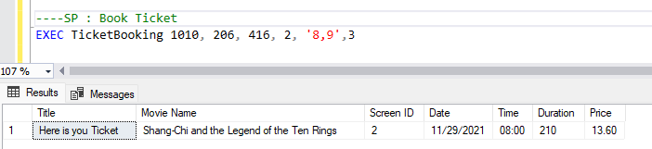
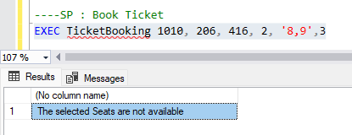
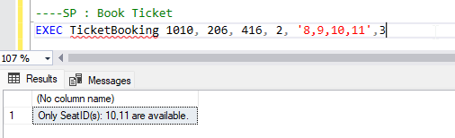
STORED PROCEDURE 3
OUTPUT:
Case 1 : Confirms booking for seat 8 and 9
Case 2 : Since seat numbers 8 and 9 are already booked it shows that the selected are not available
Case 3 : Seat numbers 8 and 9 are booked so it shows available seats

Slide 15
Database Objects - FUNCTIONS
Function To Find Average Rating of Movie
IF EXISTS(Select 1 from sys.objects where name ='GetFeedback_count')
DROP FUNCTION GetFeedback_count
GO
CREATE FUNCTION GetFeedback_count(
@movieid int
)
Returns numeric(10,2)
BEGIN
DECLARE @AvgRating numeric(10,2)
select @AvgRating=format(AVG(convert(numeric(10,2),MovieRating)),'###.##')
from Movie m
inner join Feedback f on m.MovieID=f.MovieID
where m.movieID= @movieid
GROUP BY m.MovieName
Return @AvgRating
END
Create Fn_Split Function
Drop FUNCTION [fn_split]
GO
create FUNCTION [dbo].[fn_split](
@delimited NVARCHAR(MAX),
@delimiter NVARCHAR(100)
) RETURNS @table TABLE (id INT IDENTITY(1,1), [value] NVARCHAR(MAX))
AS
BEGIN
DECLARE @xml XML
SET @xml = N'<t>' + REPLACE(@delimited,@delimiter,'</t><t>') + '</t>'
INSERT INTO @table([value])
SELECT r.value('.','Nvarchar(MAX)') as item
FROM @xml.nodes('/t') as records(r)
RETURN

Slide 16
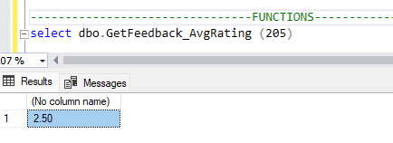
functions
OUTPUT:

Slide 17
Database Objects - Trigger
Trigger
Created an update trigger on the Customer table
IF EXISTS(Select 1 from sys.objects where name ='TR_CustomerUpdate')
Drop trigger TR_CustomerUpdate
GO
CREATE TRIGGER TR_CustomerUpdate
on Customer
for Update
as
BEGIN
DECLARE @ID int
DECLARE @OldPhone BIGINT
DECLARE @NewPhone BIGINT
DECLARE @OldEmail varchar(50)
DECLARE @NewEmail varchar(50)
DECLARE @AuditString varchar(1000)
Set @AuditString=''
Select * into #Temp from inserted
While(Exists(Select CustomerID from #Temp))
BEGIN
Set @AuditString=''
Select top 1
@ID=CustomerID,
@NewPhone=CustomerPhoneNumber,
@NewEmail=CustomerEmail
from #Temp
Select
@OldPhone=CustomerPhoneNumber,
@OldEmail=CustomerEmail
from deleted where CustomerID=@ID
Set @AuditString='Customer detail of ID: ' + convert(varchar,@ID) + ' has been updated on '
+format(getdate(), 'MM-dd-yyyy') + ' at ' + format(getdate(), 'HH:mm:ss') + '.'
IF(@OldEmail<>@NewEmail)
Set @AuditString = @AuditString + ' Email Changed from: "' + @OldEmail + '" to: "' + @NewEmail + '"'
IF(@OldPhone<>@NewPhone)
Set @AuditString = @AuditString + ' Phone Number Changed from: "' + @OldPhone + '" to: "' + @NewPhone + '"'
IF(@OldEmail=@NewEmail and @OldPhone=@NewPhone)
Set @AuditString = @AuditString + ' False Update.'
Insert into CustomerAudit values (@AuditString)
Delete from #Temp where CustomerID=@ID
END
END

Slide 18
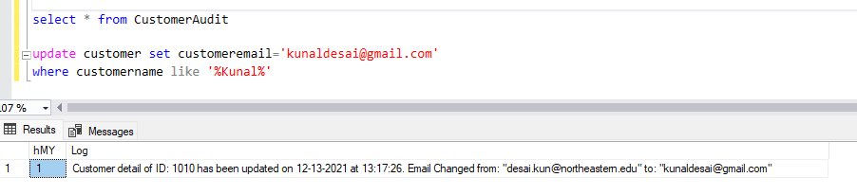
TRIGGER
OUTPUT

Slide 19
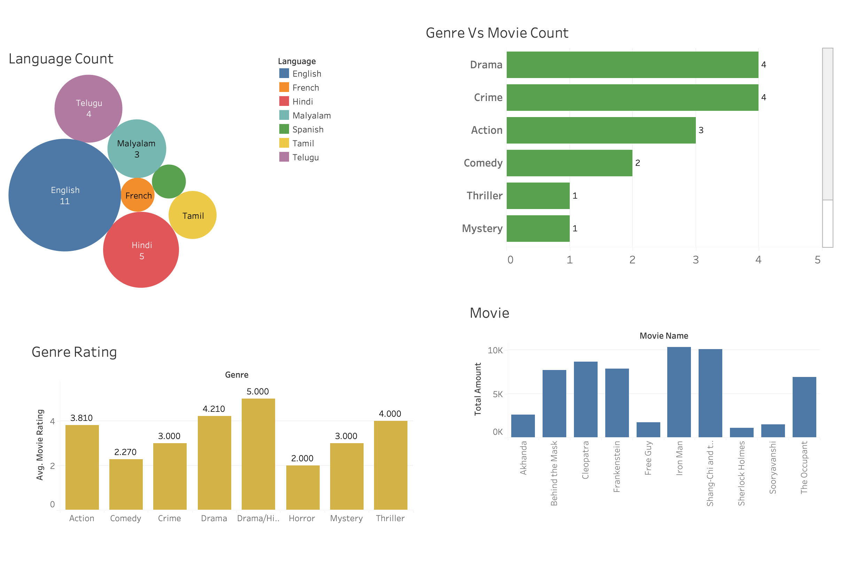
Data visualization

Slide 20
Language count
This graph shows that most movies that are currently airing in the theatres are Hollywood movies.

Slide 21
GENRE VS MOVIE COUNT
This graph shows the number of movies belonging to a particular genre

Slide 22
Total Revenue generated by a movie

Slide 23
Genre rating
Sum of Average rating of a movie for each genre.

Slide 24
Required Links
Github:-
https://github.com/desaikun1996/DMDD_MovieTicketBookingSystem/
Website for Details:-
https://sites.google.com/view/movieticketbookingsystem/

Slide 25
Thank you

